Slide 1

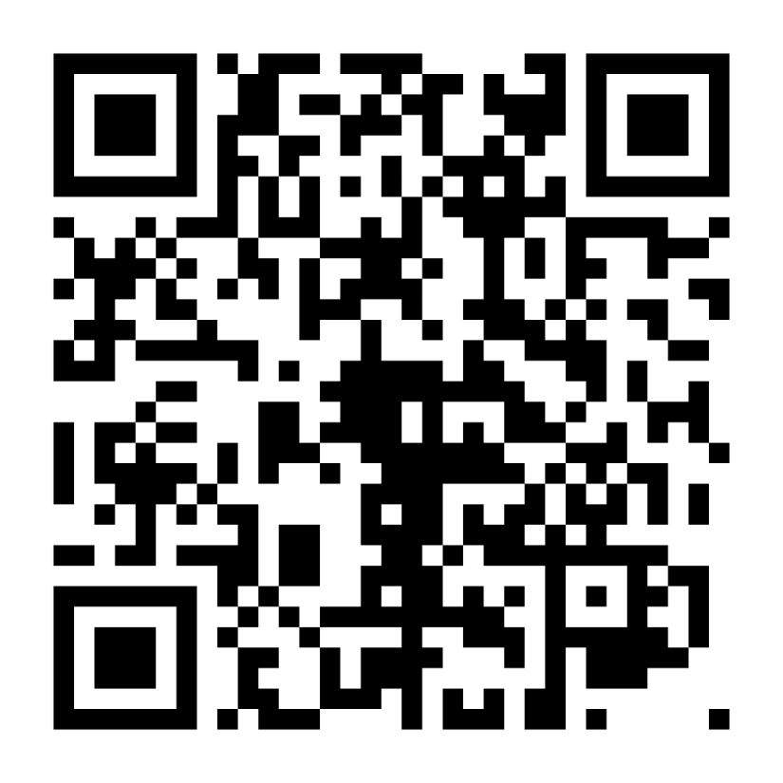
Join Us!
National Lung Cancer Screening Day
What:
When:
Saturday, November 14, 2026
A nationwide effort to increase access to lifesaving lung cancer screening
How It Works:
Screening centers across the country open their doors on a Saturday to expand access
Learn more and get involved:
Notes:
Talking Points:
The Fifth Annual National Lung Cancer Screening Day is taking place this year on Saturday, November 14, 2026.
We know that fewer than 1 in 10 eligible individuals are currently being screened, even though screening can detect lung cancer early when it’s more treatable. And we know that many people who are eligible for screening don’t get screened, often because they can’t take time off during the workweek.
The idea is simple: screening centers across the country join a national effort to expand access by opening their doors on the second Saturday in November, making it easier for people to access screening.
There are a couple of ways to get involved:
You can help by spreading the word within your network and encouraging eligible individuals to learn more.
And if your organization is in a position to participate, you can also register and be part of the effort.
You can learn more and find resources at the NLCRT website.

