Slide 1
Evaluating our Lung cancer Screening Program - Expanding the program
Spring 2022

Slide 2
Expanding Our Screening Program
Presentation Overview
Overview of our Organization
Current: We have a Lung Cancer Screening Program
Future: Expand Our Lung Cancer Screening Program
Modeling the Financial Impact at our Organization: Using LungPLAN
Expand Lung Cancer Screening Program
Program Investment
Supporting this Program
What Does the LungPLAN Financial Modeling Tell Us?

Slide 3
About Our Organization
Organization Overview
Location and communities served, service area, service lines, number of admissions, outpatient visits, net revenue, other
Any other general information to help “frame” the organization
Focus on Lung Cancer
Cancer incidence rate in our community
How is our organization involved with lung cancer in our community?
What current resources do we have to treat lung cancer patients?
LDCT Scanning capabilities
Cancer surgical service lines
Nurse Navigators tracking and assisting patients
Comparison of eligible screening volume to actual screened volume

Slide 4
Current – Lung Cancer Screening
What are we currently doing at our Organization?
We have a Lung Cancer Screening Program
Show actual number of screened as compared to eligible population
Our program is working, but with new CMS Guidelines, we can increase screening volume
Not sure if we should invest in this program or not?
What is the financial justification, if any?
Will I need to make any further investments?

Slide 5
Future – Expand Lung Cancer Screens
Future
Expand Lung Cancer Screening Program - Increase Screening Volumes
Consider: Initiate smoking cessation programs, add additional clinical staff (e.g. Nurse Navigators) to support screened patients, buy software to support program, evaluate and consider other types of outreach programs
Evaluate our current program and determine where to improve
Model the financial impact of Lung Cancer Screening program for next 5 years
What type of investment does organization need to make to support this program?

Slide 6
Modeling Financial Impact – LungPLAN
Using LungPLAN to Assist in our Decisions
Expand Lung Cancer Program
What information do we need to determine financial impact of 5-years?
Evaluate current programs and projected volume
Consider new programs, will these increase screening volume?
Model projected screening volumes
Once modeled, analyze the financial results
Evaluate results:
Include clinical, financial, administrative, and others
Adjust modeling based on feedback
Decide on specific next steps

Slide 7
LungPLAN – Lung Cancer Screening
Model Annual Lung Cancer Screening volume for 5-Years
Screening Reimbursement for 5-years
Show financial impact of expanding lung cancer screens

Slide 8
LungPLAN – Financial Impact
LungPLAN Financial value table: Revenue streams for 5-years

Slide 9
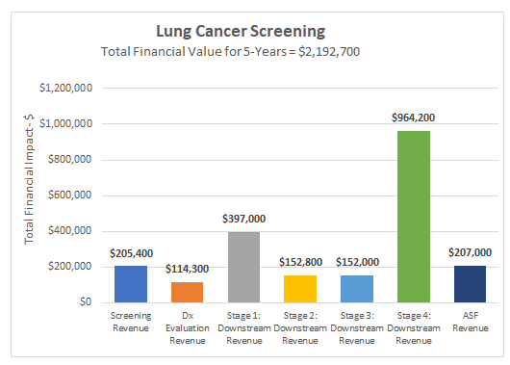
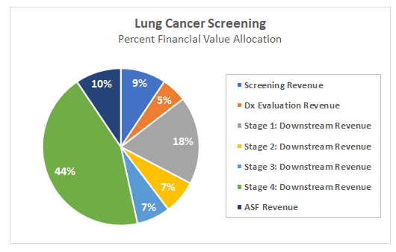
LungPLAN – Financial Impact
Financial value: Bar Graph/Pie Chart
Financial impact over 5-year time period

Slide 10
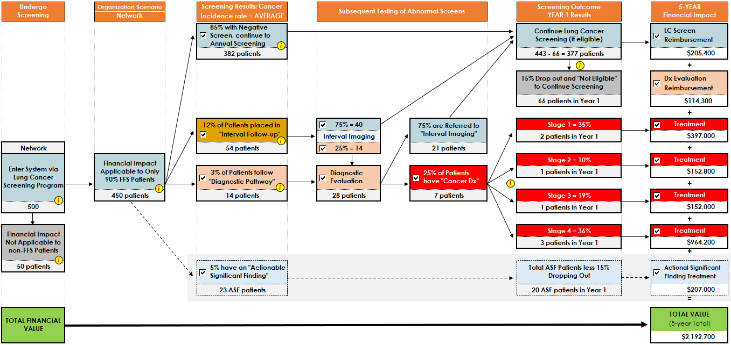
Lung Cancer Workflow: 5-years
Modeled result of the Lung Cancer patient flow over 5-years

Slide 11
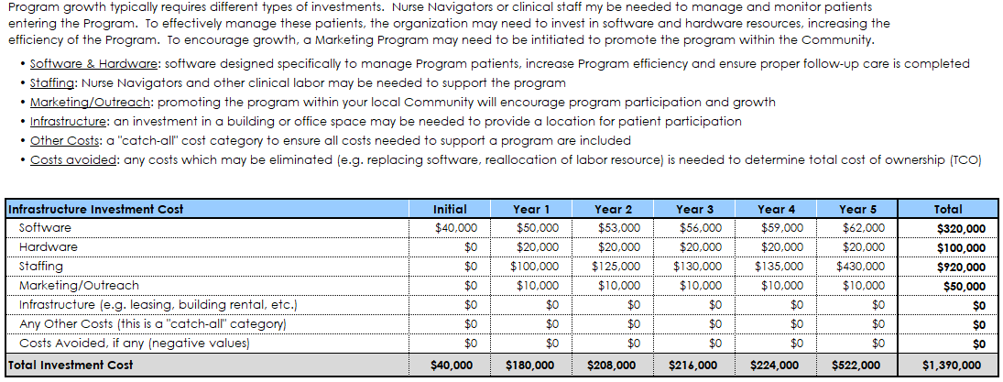
Investment Costs
Investment needed to support a Lung Cancer Screening Program

Slide 12
LungPLAN Output
What Does the LungPLAN Output Tell Us
Modeled lung cancer screening volumes for 5-years
Modeled investments needed to support and grow the program
All reimbursement values validated by Finance
Based on the Output
Increased financial value of $2,721,000 over 5-years
Modeled screening reimbursement and downstream surgery revenue
Investment of $1,390,000 to support expanding program
Conclusion: Invest In Expanding our Lung Cancer Screening Program

